Slide 1

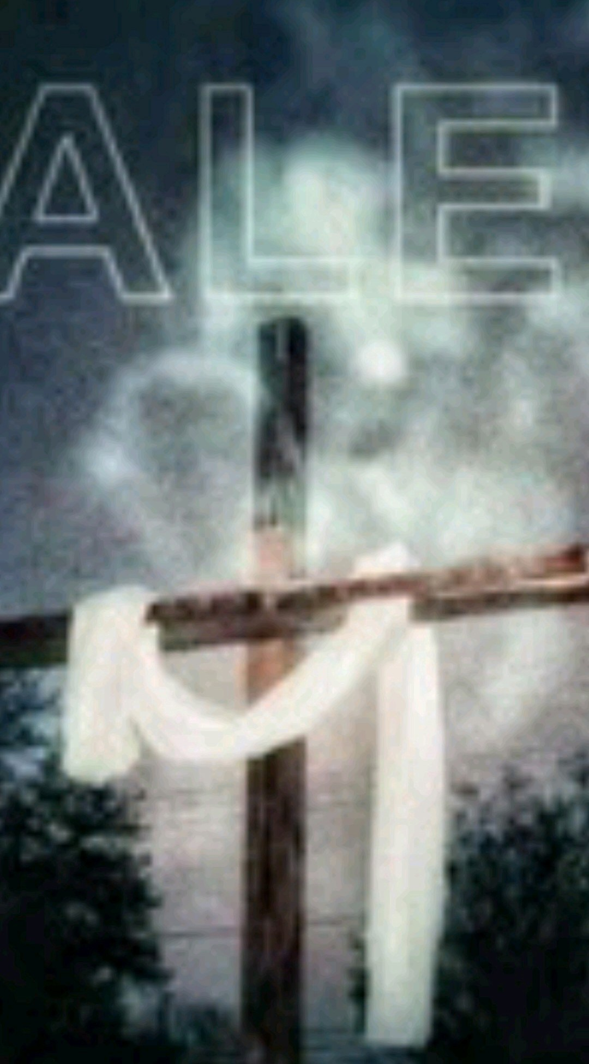
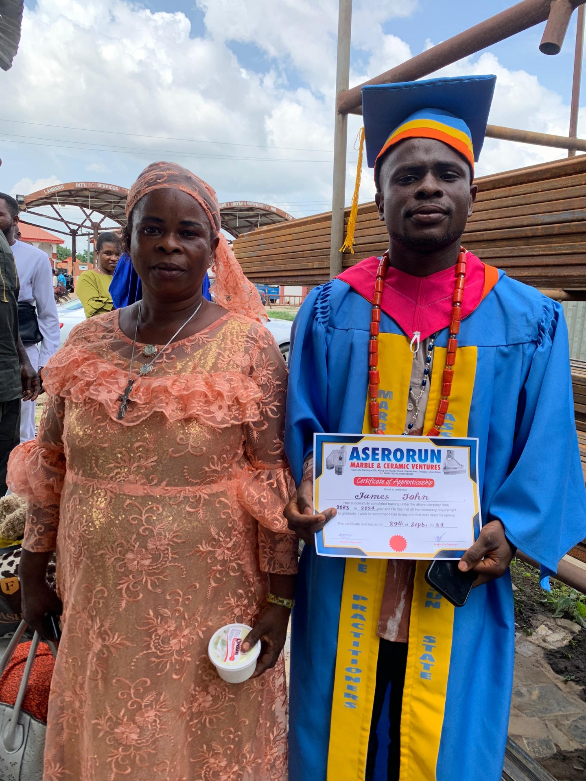
[
(1)

Slide 2
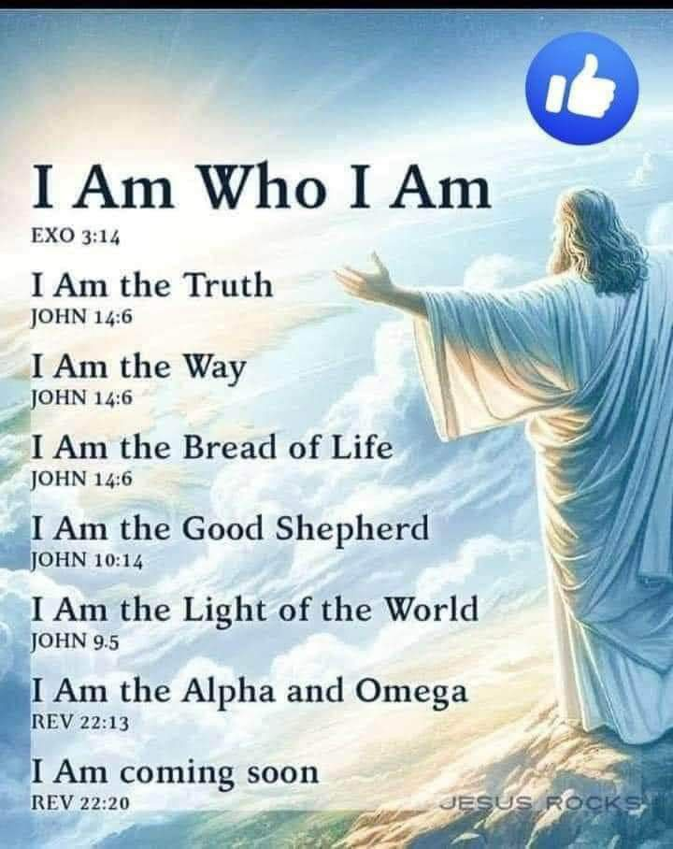
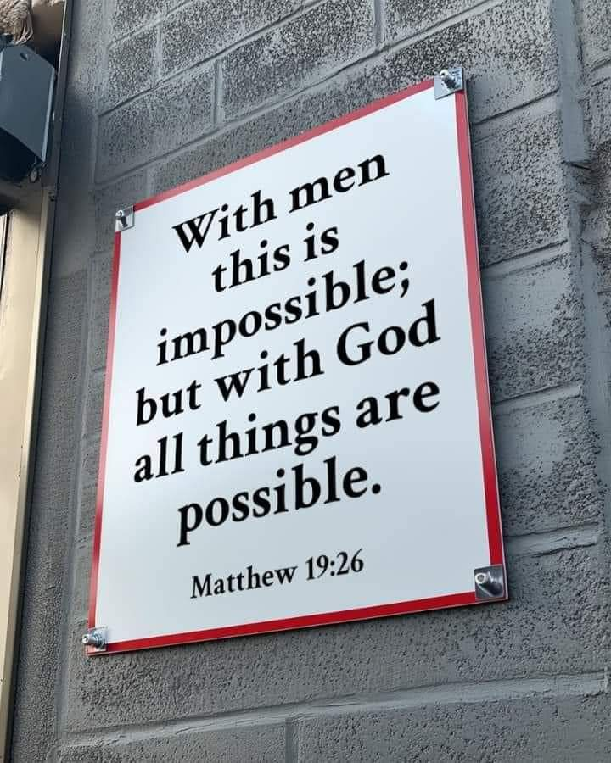

Slide 3

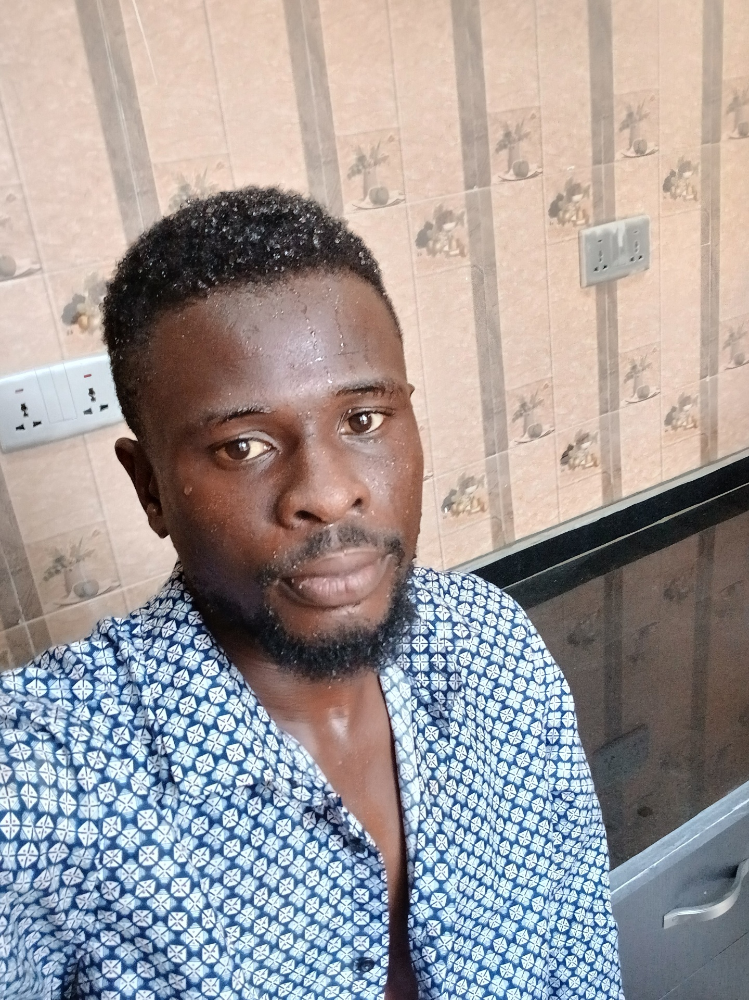
PSALMS 51
Have mercy upon me, O God, according to thy lovingkindness: according unto the

Slide 4
multitude of thy tender mercies blot out my transgressions.
Wash me throughly from mine iniquity, and cleanse me from my sin.
For I acknowledge my transgressions: and my sin is ever before me.
Against thee, thee only, have I sinned, and done this evil in thy sight: that thou mightest be justified when thou speakest, and be clear when thou judgest.
Behold, I was shapen in iniquity; and in sin did my mother conceive me.
Behold, thou desirest truth in the inward parts: and in the hidden part thou shalt make me to know wisdom.

Slide 5
Purge me with hyssop, and I shall be clean: wash me, and I shall be whiter than snow.
Make me to hear joy and gladness; that the bones which thou hast broken may rejoice.
Hide thy face from my sins, and blot out all mine iniquities.
Create in me a clean heart, O God; and renew a right spirit within me.
Cast me not away from thy presence; and take not thy holy spirit from me.
Restore unto me the joy of thy salvation; and uphold me with thy free spirit.
Then will I teach transgressors thy ways; and sinners shall be converted unto thee.

Slide 6
Deliver me from bloodguiltiness, O God, thou God of my salvation: and my tongue shall sing aloud of thy righteousness.
O Lord, open thou my lips; and my mouth shall shew forth thy praise.
For thou desirest not sacrifice; else would I give it: thou delightest not in burnt offering.
The sacrifices of God are a broken spirit: a broken and a contrite heart, O God, thou wilt not despise.
Do good in thy good pleasure unto Zion: build thou the walls of Jerusalem.
Then shalt thou be pleased with the sacrifices of righteousness, with burnt offering and whole burnt offering: then shall they offer bullocks upon thine altar.

Slide 7
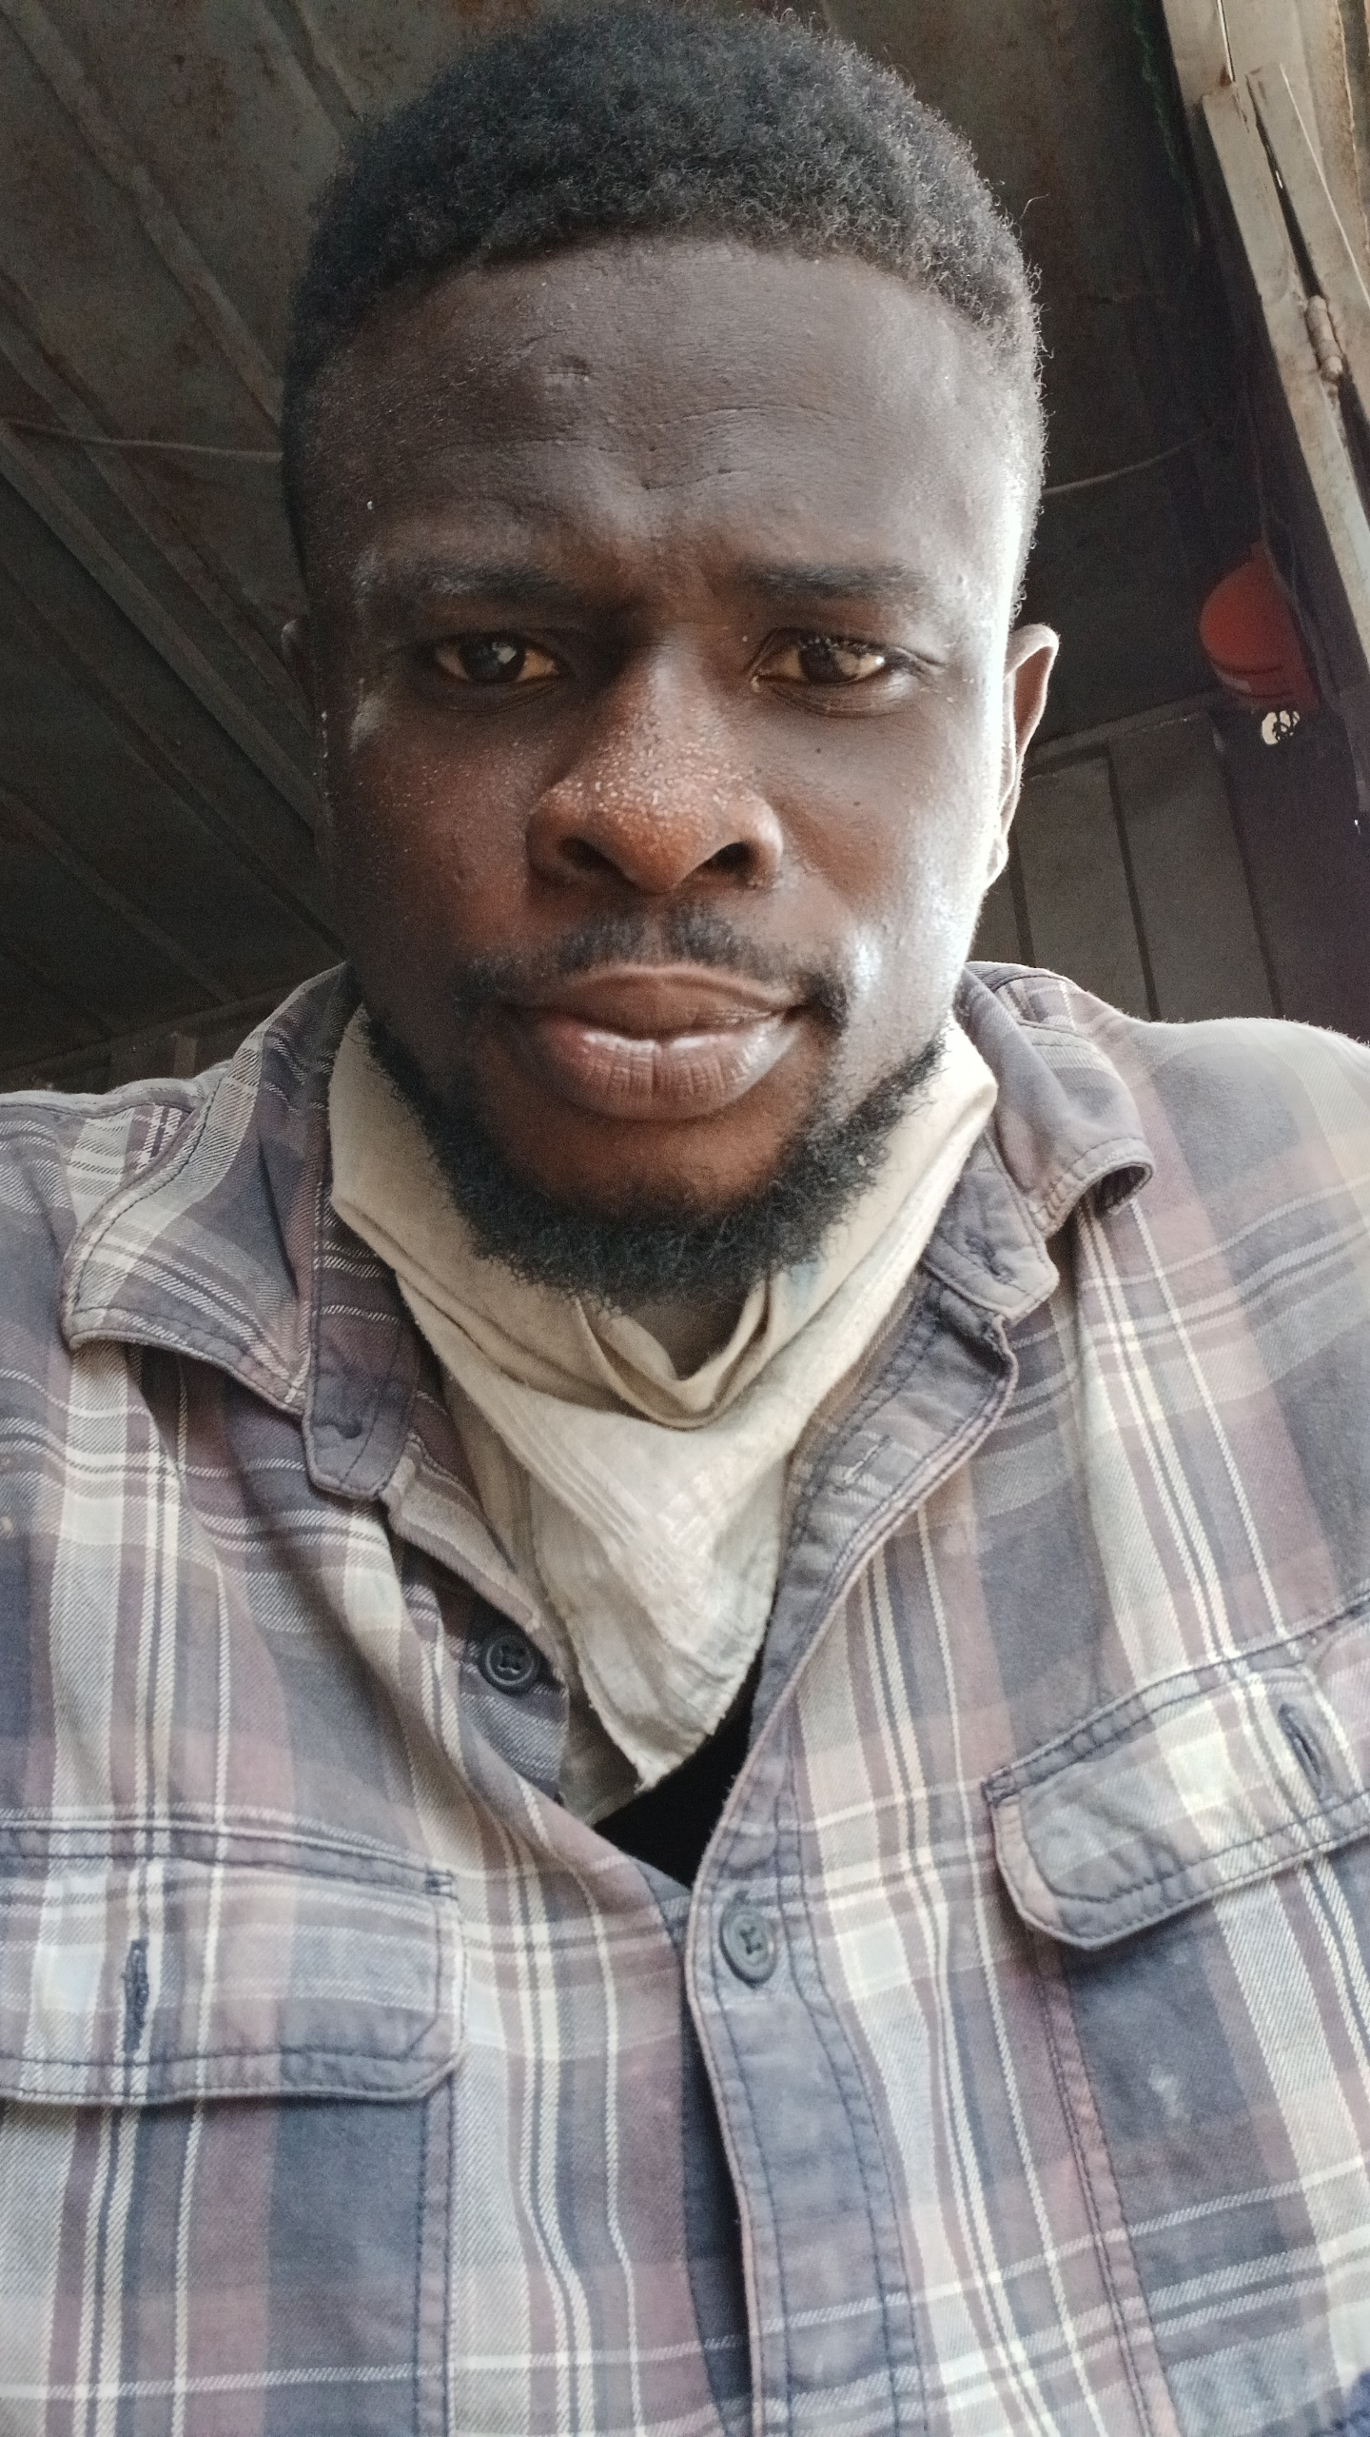
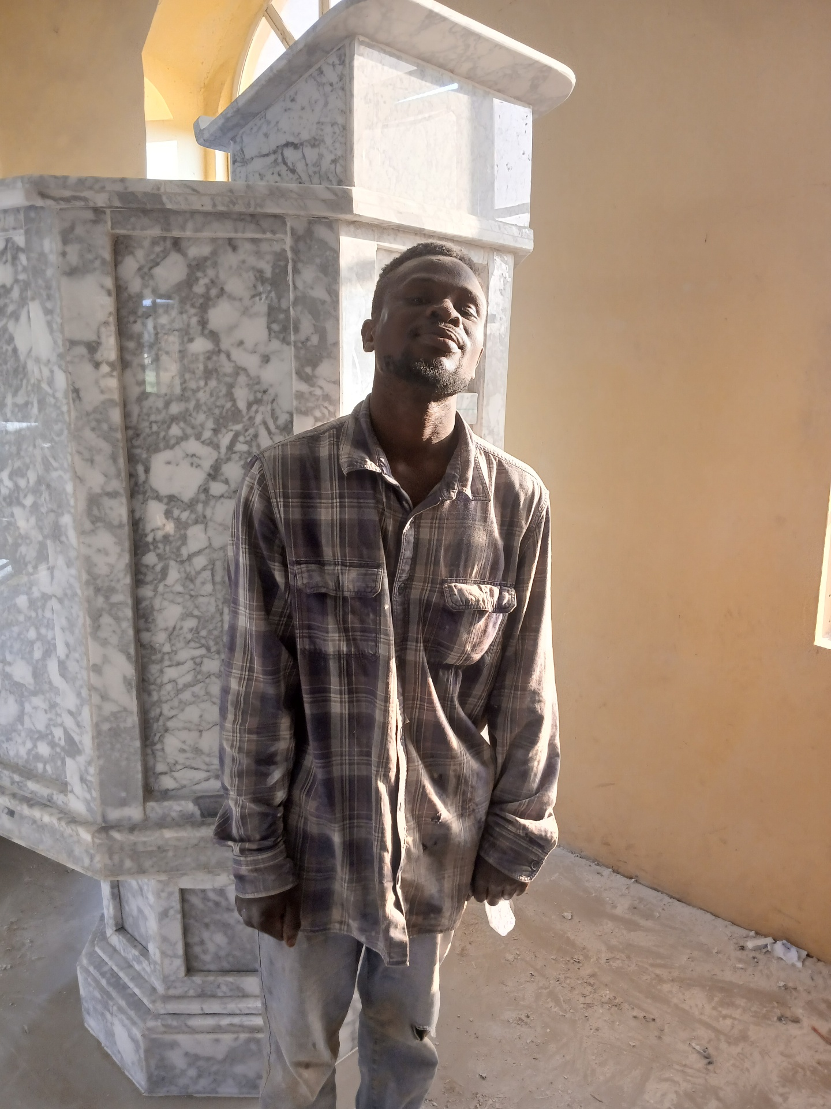

Slide 8
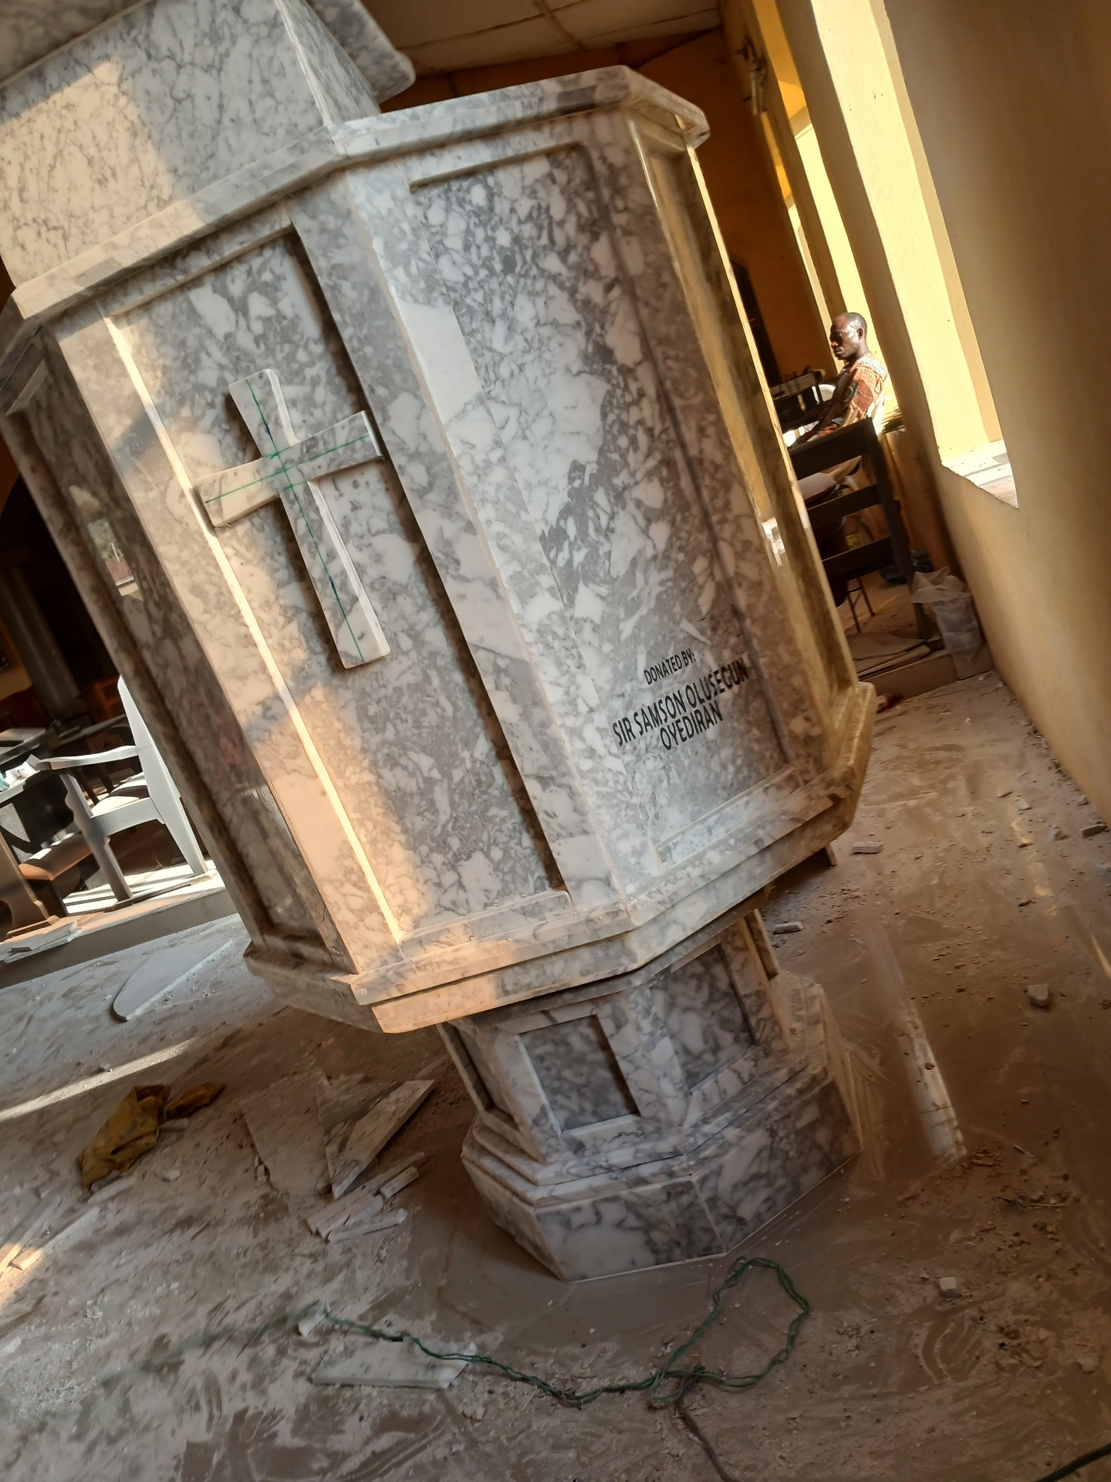
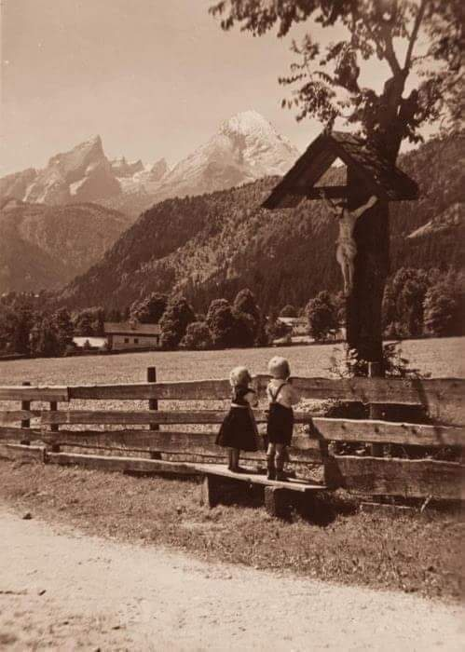

Slide 9
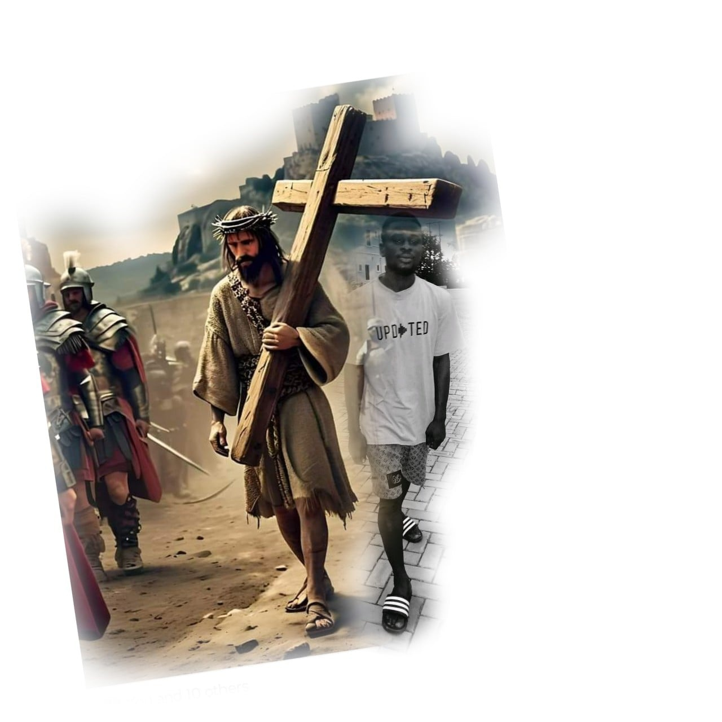
(2) PSALM 24
The earth is the LORD's, and the fulness thereof; the world, and they that dwell therein.
For he hath founded it upon the seas, and established it upon the floods.
Who shall ascend into the hill of the LORD?

Slide 10
or who shall stand in his holy place?
He that hath clean hands, and a pure heart; who hath not lifted up his soul unto vanity, nor sworn deceitfully.
He shall receive the blessing from the LORD, and righteousness from the God of his salvation.
This is the generation of them that seek him, that seek thy face, O Jacob. Selah.
Lift up your heads, O ye gates; and be ye lift up, ye everlasting doors; and the King of glory shall come in.
Who is this King of glory? The LORD strong and mighty, the LORD mighty in battle.
Lift up your heads, O ye gates; even lift

Slide 11
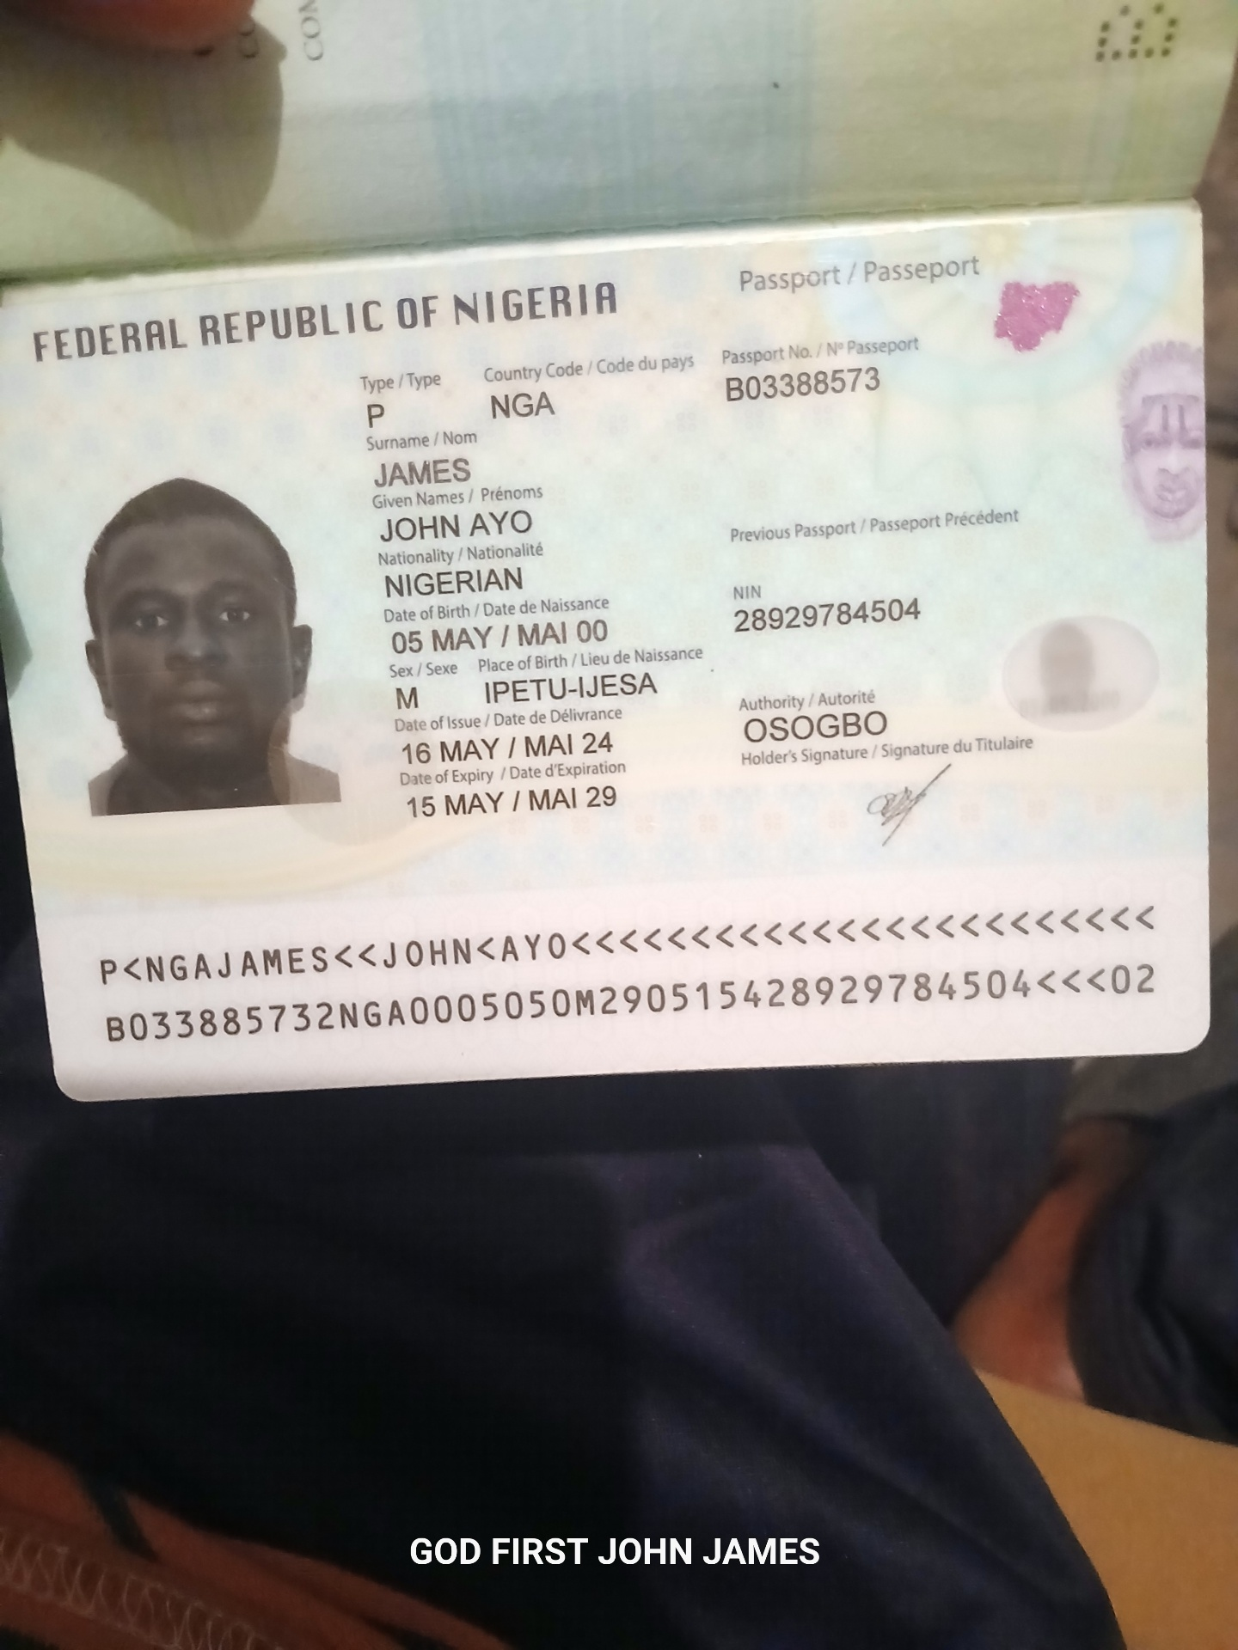
them up, ye everlasting doors; and the King of glory shall come in.
Who is this King of glory? The LORD of hosts, he is the King of glory. Selah.

Slide 12

(3) PSALMS 20
The LORD hear thee in the day of trouble; the name of the God of Jacob defend thee;
Send thee help from the sanctuary, and strengthen thee out of Zion;
Remember all thy offerings, and accept thy

Slide 13
burnt sacrifice; Selah.
Grant thee according to thine own heart, and fulfil all thy counsel.
We will rejoice in thy salvation, and in the name of our God we will set up our banners: the LORD fulfil all thy petitions.
Now know I that the LORD saveth his anointed; he will hear him from his holy heaven with the saving strength of his right hand.
Some trust in chariots, and some in horses: but we will remember the name of the LORD our God.
They are brought down and fallen: but we are risen, and stand upright.

Slide 14

Save, LORD: let the king hear us when we call.

Slide 15
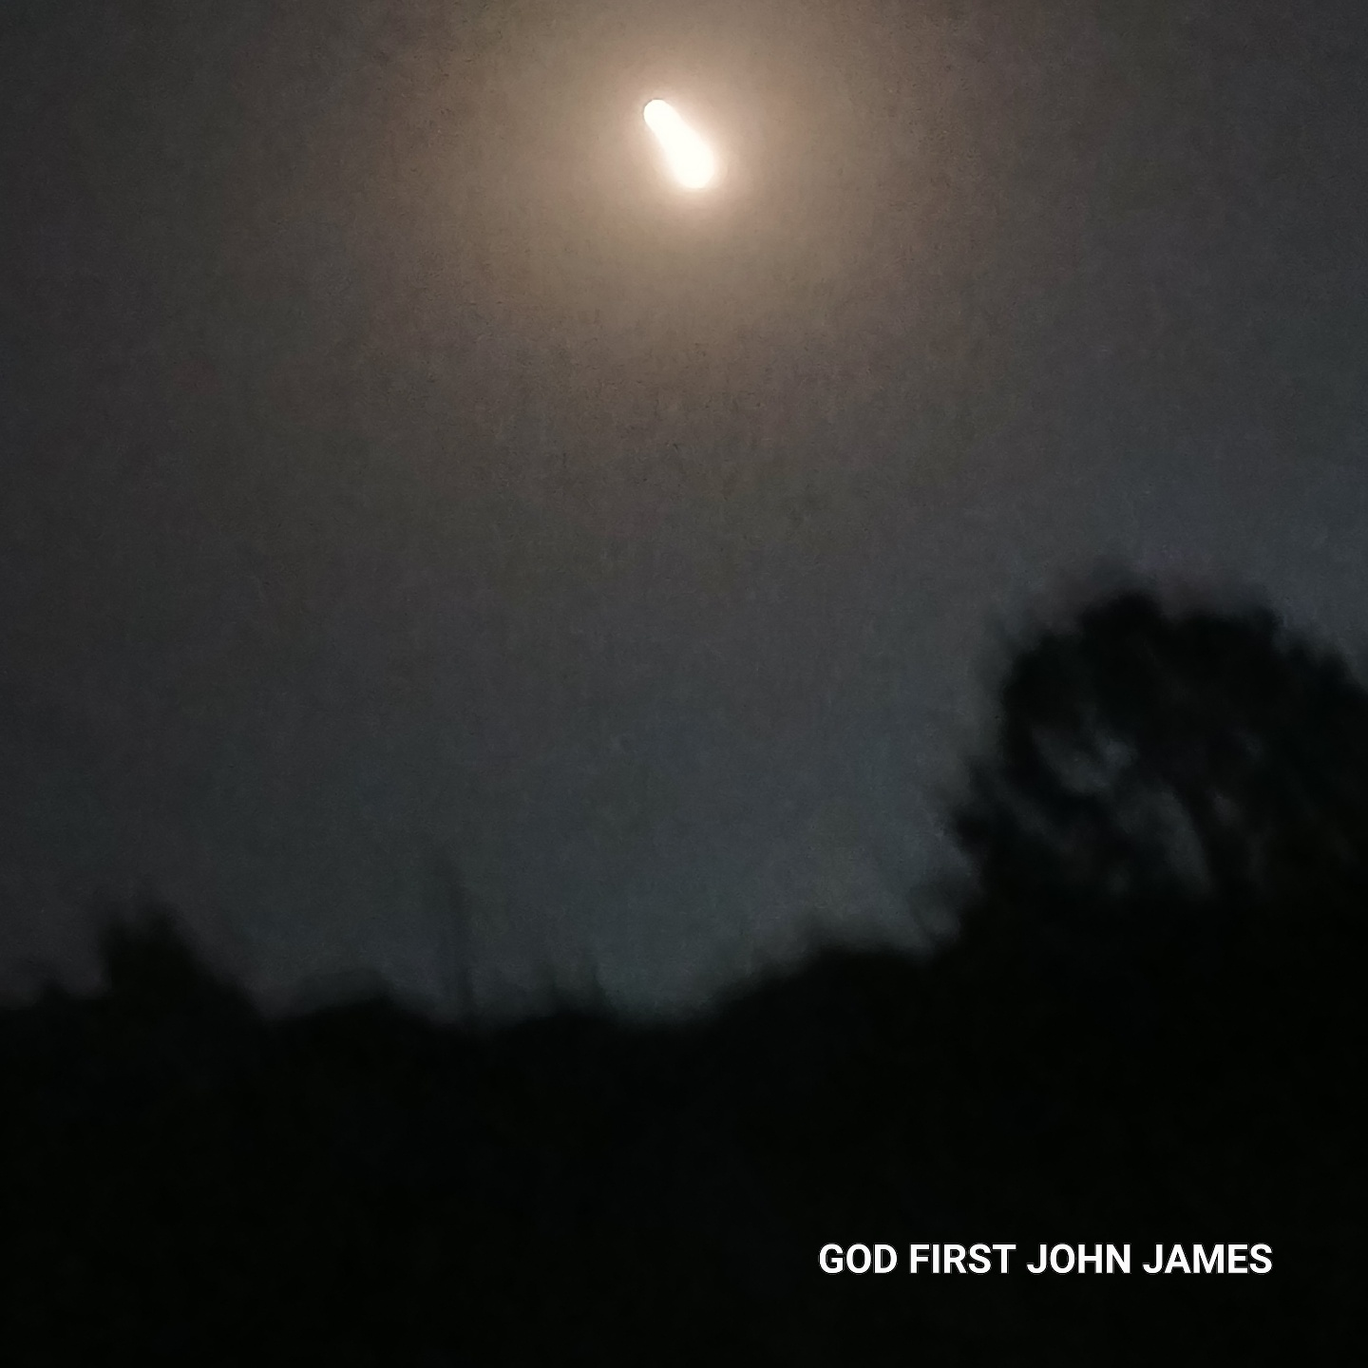
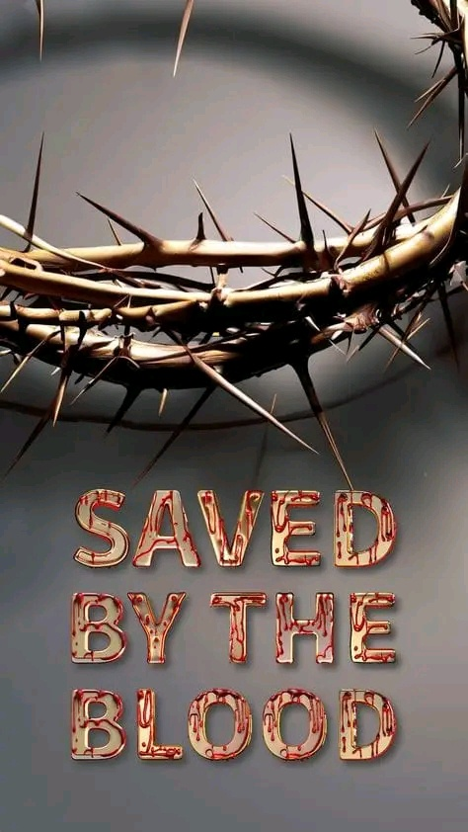

Slide 16
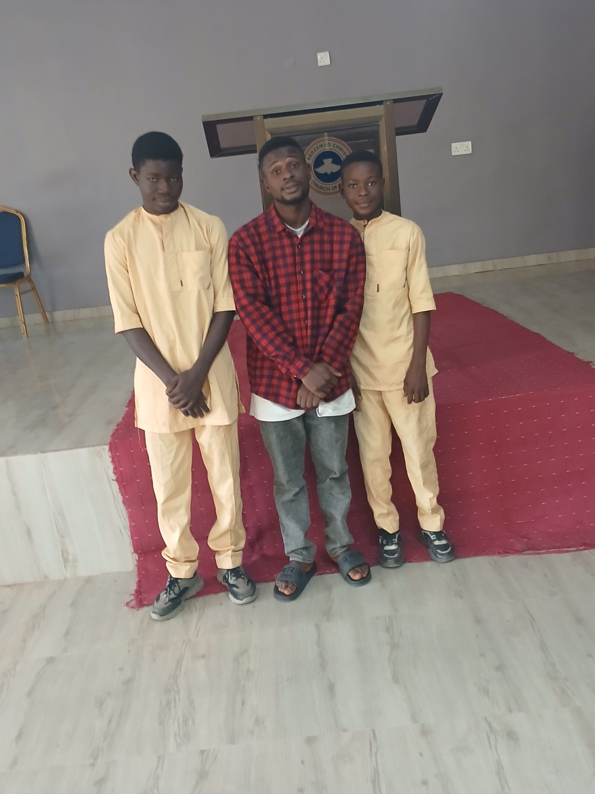
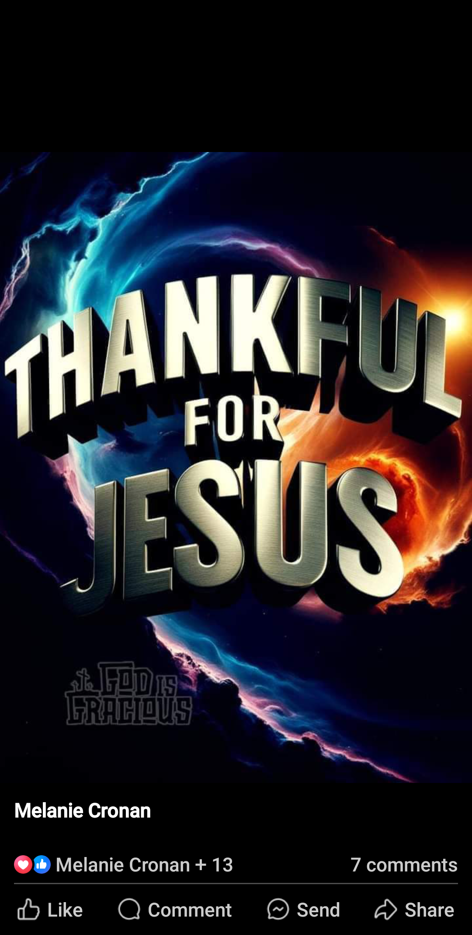
THANK YOU JESUS CHRIST SON OF LIVING GOD

Slide 17
THANK YOU JEHOVAH.
]

